Slide 1
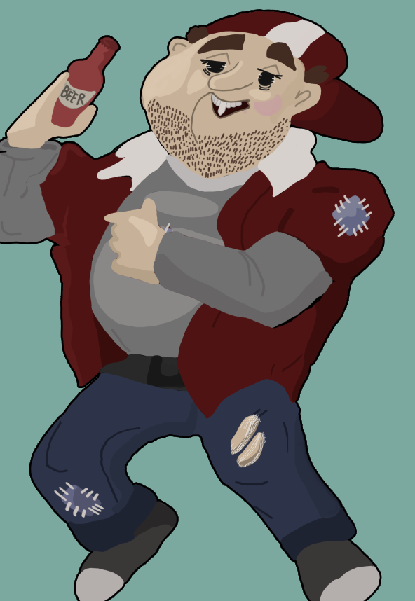

Level 4/5 Group 10
Courtney-Jade Pearson S185717 Thomas McCarthy S183168
Aaron Kegge S186229

Slide 2
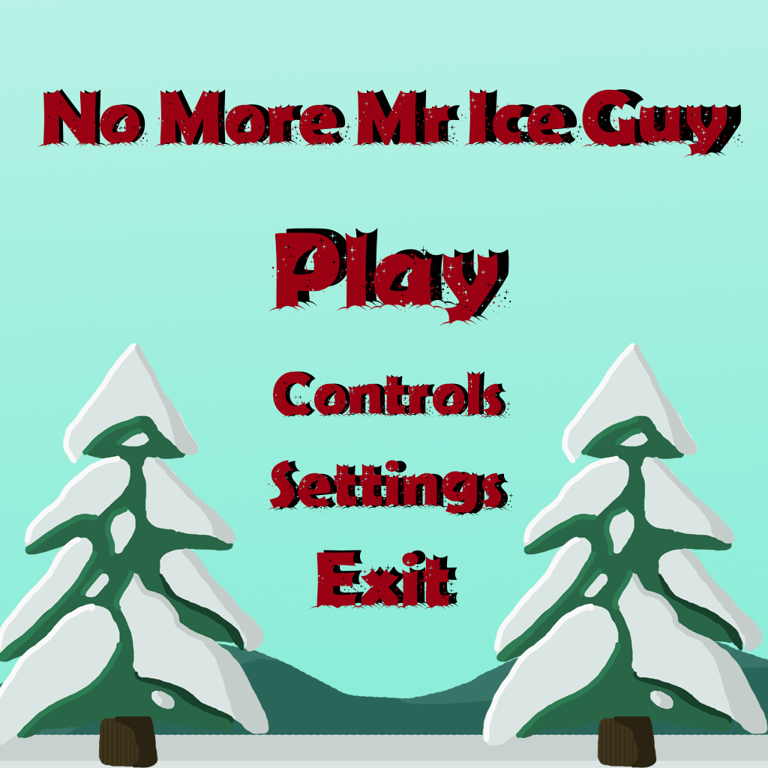
No More Mr Ice Guy: Genre / style
Humorous 2D platformer
PC only
Competitive 2 players
Real time

Slide 3
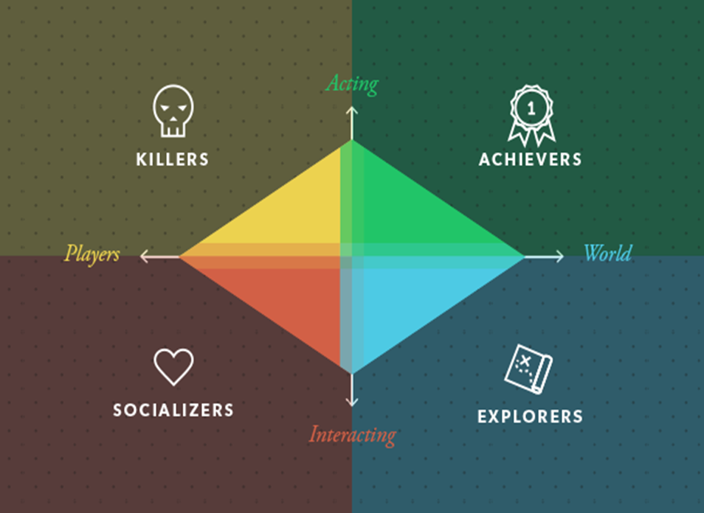
Target Demographic
Socializers and Achievers
Age 16+
Gender: Males and Females

Slide 4
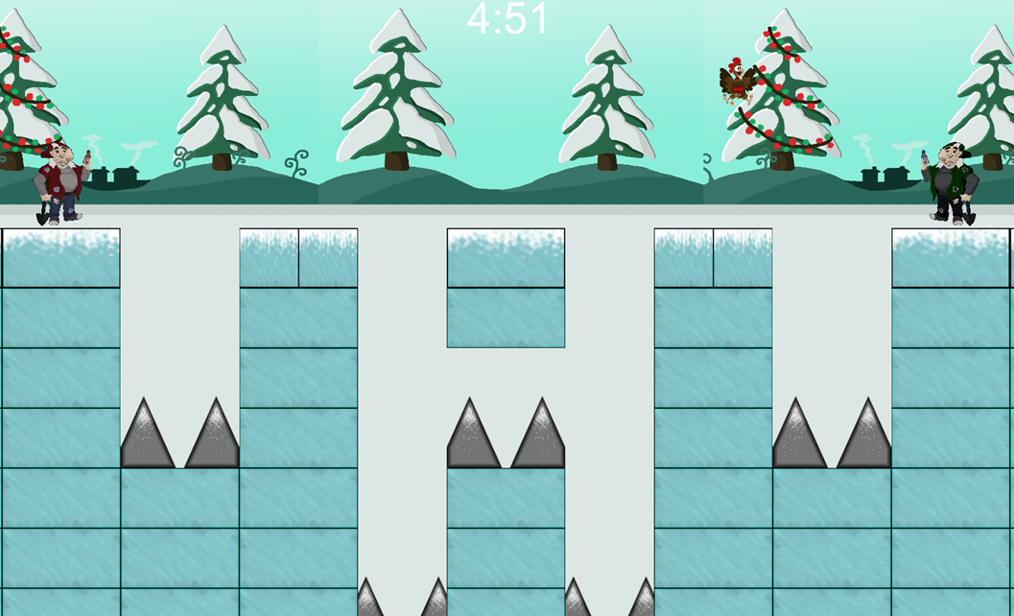
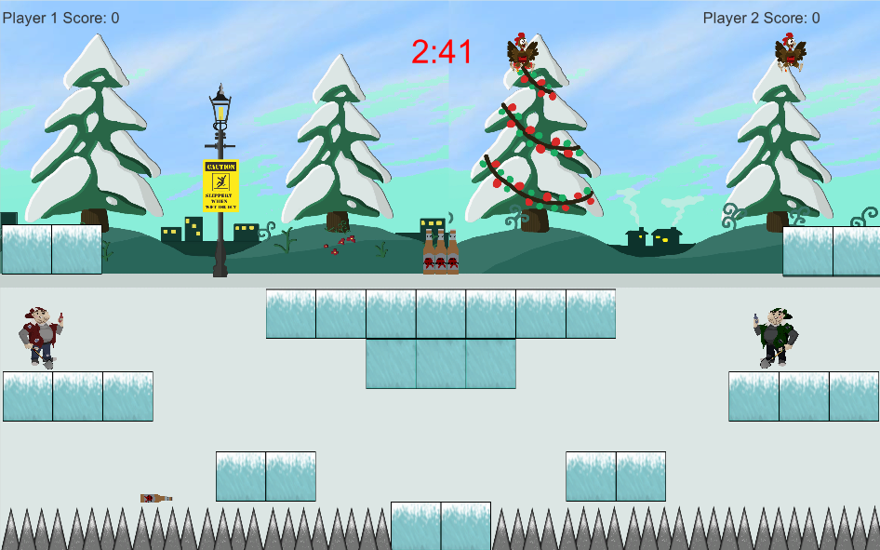
Visual hierarchy

Slide 5
How does our game relate to the brief?
2D environment
Gravity, Friction, Time
Adversarial – 2 players
Played on a single device
Symmetric Gameplay
Simple and intuitive rules

Slide 6

Mechanics
Symmetric mechanics
Point system
Timer
Hitting
Double jumping

Slide 7

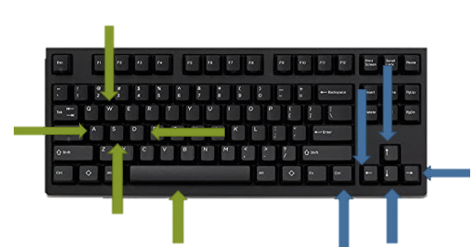
What does the player do?
Button press
Competitive
Reflex – Avoid Damage
Triumph

Slide 8
Prototype

Slide 9
Play Testing Feedback
Digging mechanic removed
Controls
Level design improvements
Prefer the point collection

Slide 10
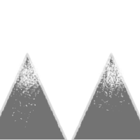

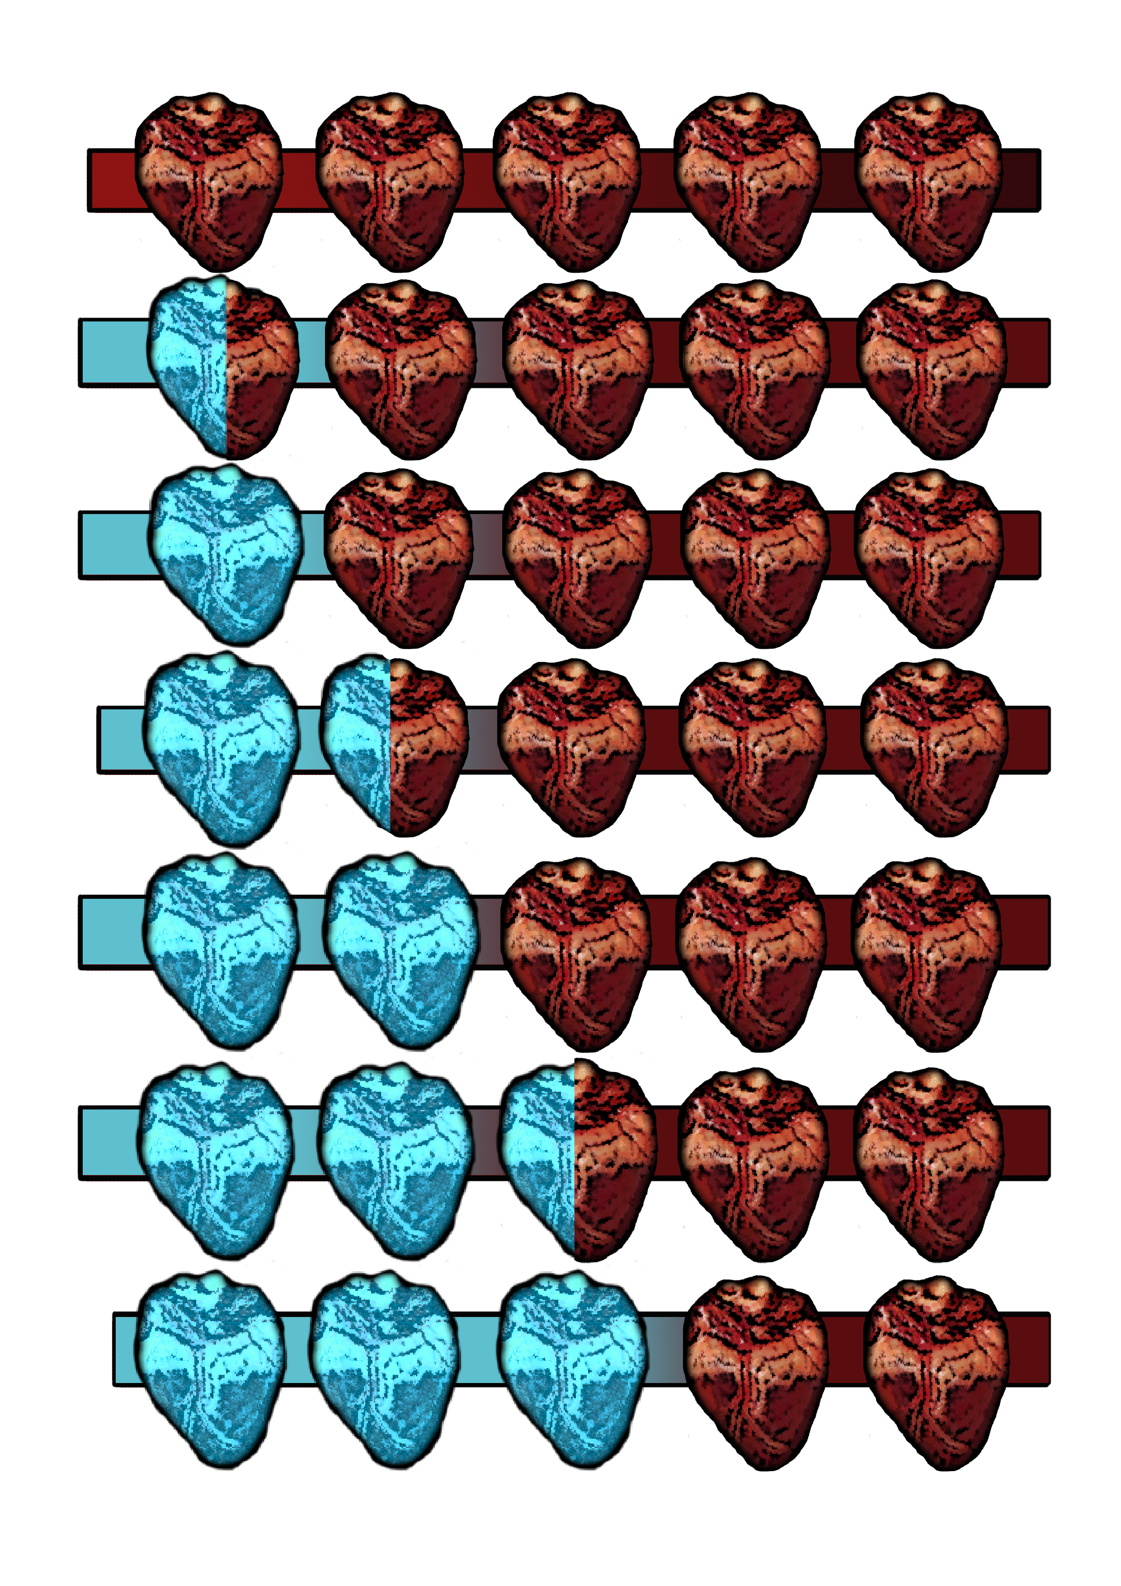
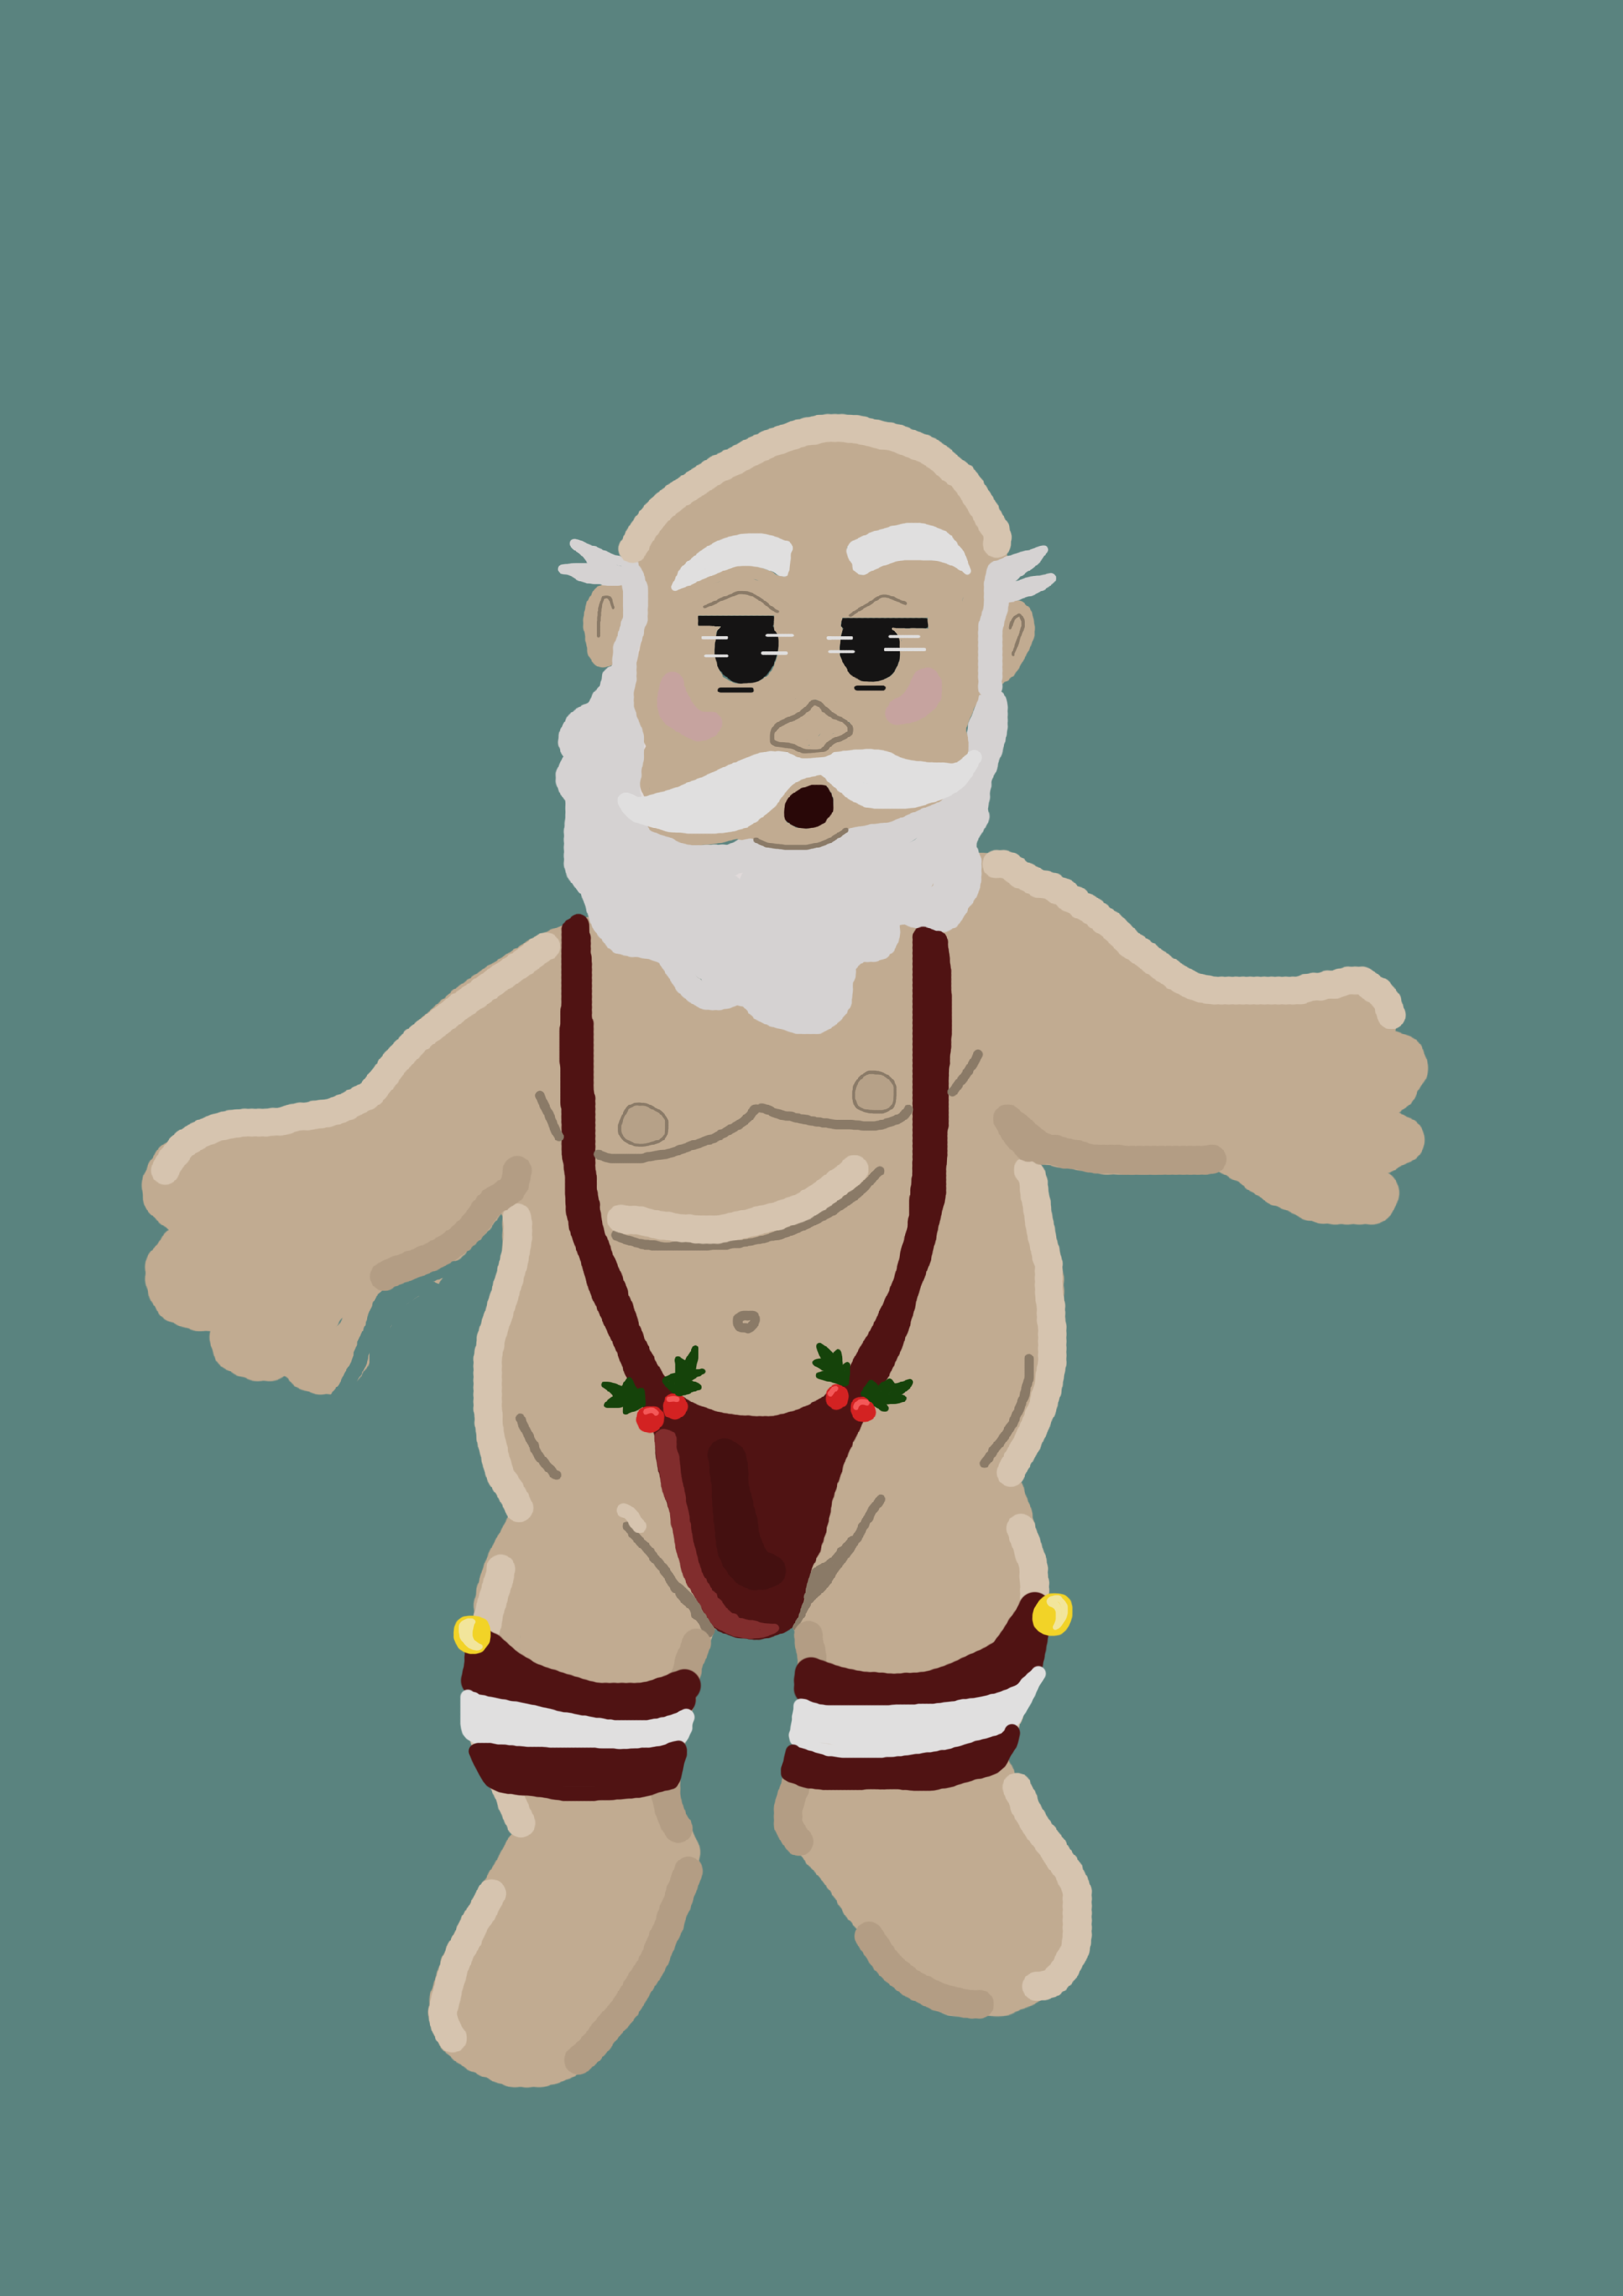
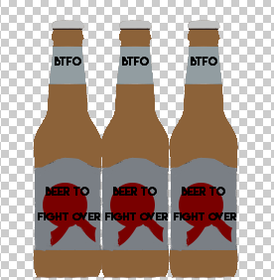
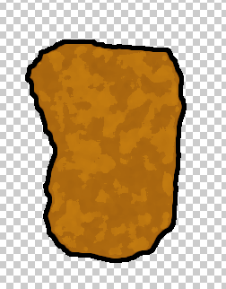

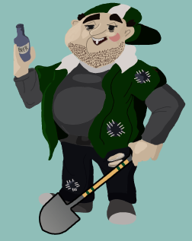
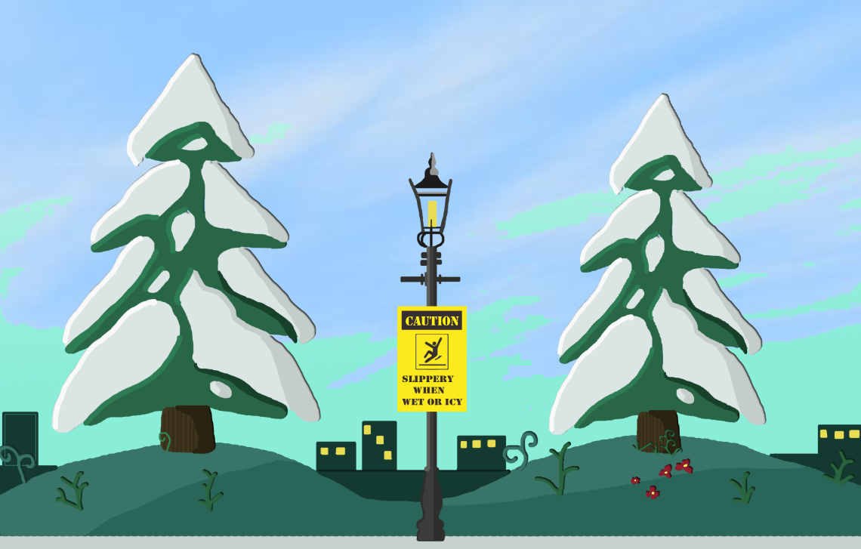




Art assets

Slide 11
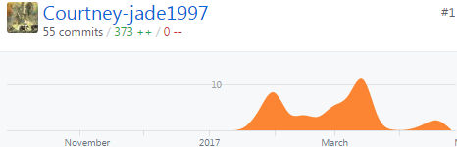
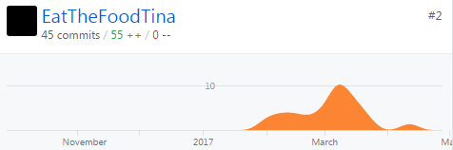
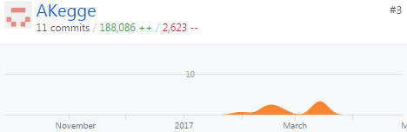
Contribution
Aaron kegge: 39 Hours
Thomas McCarthy: 39 Hours 30mins
Courtney Pearson: 46 Hours 60mins

Slide 12
Lessons learnt
Contribution
Back up files
Timing is important

Slide 13
Any Questions?

